Slide 1

BMI Calculator
Pravin kumar singh
21MCA3111
Guided by:
Mrs:Pawandeep sharma
DISCOVER . LEARN . EMPOWER

Slide 2
Introduction
The Body Mass Index (BMI) is calculated by putting your body’s height and you weight into relation and is commonly accepted as a better method in comparison to the formulae
It was invented by Belgian polymath Adolphe Quetelet in the 1800s and consequently is sometimes called the Quetelet index.
The BMI is calculated by dividing your weight in kilograms (kg) by your height in centimeters squared (cm2) and it is expressed as kg/cm2.

Slide 3
Used Technology
The Complete project is made in python language. The used Libraries are,
Tkinter– This is the most commonly used library for developing GUI (Graphical User Interface) in Python
messagebox– The Tkinter tkMessageBox has various methods to display a message box
The IDE which is used for the project is vs code.

Slide 4
Need of the project
Research has shown that BMI is strongly correlated with the gold-standard methods for measuring body fat.
It is an easy way for clinicians to screen who might be at greater risk of health problems due to their weight.

Slide 5
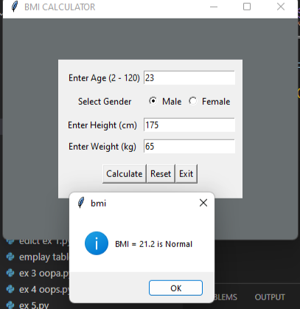
Objective
The objective of this project are,
To calculate BMI and categories outcome . Explain inaccuracies of using BMI as a health indicator.
Calculating BMI of the Male & Female Calculating BMI = mass in kg / (height in cm)*2

Slide 6
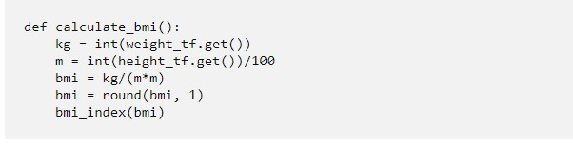
Functions Explanation:
Two functions used to display the BMI result.
calculate_bmi()-
kg = int(weight_tf.get())this line of code gets the user weight, convert it to integers, and then stores the value in the variable kg
m = int(height_tf.get())/100 this line of code gets the user height, converts it into integers, divides the result with 100 so that centimeters become meters, and then stores it in a variable m.
bmi = kg/(m*m)this is the formula for finding BMI. We have stored the formula in a variable BMI.
bmi = round(bmi, 1)before round off the result was appearing in multiple decimal values. But after using the round function it looks simplified & easy to read. without round function, the result appeared is 20.061728395061728 and after applying the round function the result appeared is 20.1.
bmi_index(bmi)We have called the bmi_index() function to compare the BMI value with the BMI categories.

Slide 7
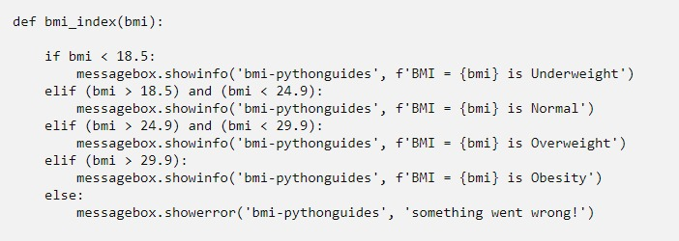
Functions Explanation:
bmi_index():
In this function, the final result displayed depending upon the BMI value & BMI category it belongs to.
BMI Categories:
Underweight = <18.5
Normal weight = 18.5–24.9
Overweight = 25–29.9
Obesity = BMI of 30 or greater

Slide 8
Output:
In this output, the user needs to fill in some information like age, gender, height & weight. Out of this information height & weight is used to calculate the BMI. Then the BMI passes through conditions.
Each condition has a remark (underweight, Normal, overweight, etc). The result is displayed using a message box.

Slide 9
Future Scope
Our model predictions of obesity are generally lower than previous Foresight model predictions
There are a number of advantages of the BMI distribution we can do exercise as per our BMI .
The results of the BMI have important implications for population well-being and funding for treatment of obesity-related diseases
GitHub Link -https://github.com/rakraosahab

Slide 10

THANK YOU

